Slide 1
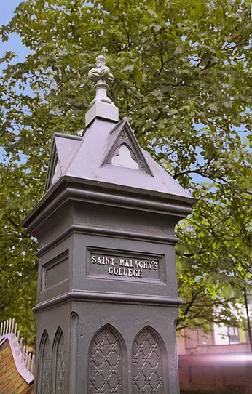

Welcome to Year 10
Parent Information Session

Slide 2
SDP KS3 Update
(August 2025)

Slide 3
Key Messages
To reflect on SDP Outcomes and progress made in 2024/25
To share next steps 2025/26

Slide 4
Whole School Areas of Focus
Raising Standards through High Quality Teaching and Learning
Raising Standards through High Quality Pastoral Care
Curriculum and Extracurricular Development to include Collaboration and Careers Education
Pupil & Staff Development, Accommodation and Resources

Slide 5
Areas of Focus 2023-26
(Raising Standards through High Quality Teaching and Learning)
Smart Target – By June 2026 in all departments there will be a continued focus on improving the quality of provision with emphasis on the areas outlined below
Continued focus on Retrieval Practice and Reteaching Material where necessary (Rosenshine)
Continue to develop Digital Learning opportunities within and between departments (Extend KS3 Timetable Provision & Collaboration opportunities)
Continue to strengthen pupils’ employability skills through their subject learning experiences (Communication/Creativity/Innovation/Entrepreneurship)
Refresh our focus on developing pupils TS & PC (Awareness of, and opportunities to reflect on skills development)
KS3 Careers Provision to be reviewed and updated
KS3 Preventative Curriculum under review – updated PV Curriculum in place 2025/26
Renewed focus on ensuring consistency in the quality of KS3 Assessment Practice and pupil feedback

Slide 6
Progress Made 2024-25
(Raising Standards through High Quality Teaching and Learning)
Smart Target – By June 2026 in all departments there will be a continued focus on improving the quality of provision
Actions
HODs led their teams focus on these SDP priorities as relevant to individual departmental position
HOS presented on the new Inspection Model placing it within our College context
Three HODs presented on approaches to Departmental Self-Evaluation to whole staff
KS3 Pupils continued to experience lessons in the Digital Hub

Slide 7
Progress Made 2024-25
(Raising Standards through High Quality Teaching and Learning & Curriculum and Extracurricular Development to include Collaboration and Careers Education)
Smart Target – By June 2025 lessons learned from our focus on Rosenshine’s Principles will be used to inform the planning for, and introduction of, a wider framework for teaching and learning within the College
Work of the T & L Group was ongoing throughout the year
T& L Group and Colleagues completed work on the College Framework for T&L
Whole staff presentation on the Framework in April’ 25
Three Areas of Focus
1. Effective Teaching Strategies
2. Effective Assessment Strategies
3. Effective Behaviour Management Strategies (inc. College Routines)

Slide 8
Next Steps 2023-26
(Raising Standards through High Quality Teaching and Learning & Curriculum and Extracurricular Development to include Collaboration and Careers Education)
Departments to gauge progress made in 2024/25 and identify actions for 2025/26 in relation to KS3 Curriculum Development (Slide 4 list of areas)
T& L Group to make use of the new Framework Document to support self-evaluation of T&L experiences within their lessons
College to meaningfully engage with DE’s ‘Science of Learning’ CPD programme
KS3 pupils will experience increased allocation of timetabled lessons in the Digital Hub
To plan for, and trial a Skills Pupil Profile

Slide 9
KS3 Outcomes (2023-26)
(Raising Standards through High Quality Pastoral Care & Pupil and Staff Development, Accommodation and Resources)
The Behaviour Management Policy and Stepped Consequences are fully implemented in an appropriate and consistent manner
Implementation of the Positive Behaviour Chart (inc. Rewards) is sustained and further enhanced, as possible
The Preventative Curriculum is reviewed and updated to ensure relevant and appropriate educative support to pupils for the issues they may be experiencing inside and outside school
The College attendance figures will be in line or exceed the NI average for schools of a similar type
The College’s approach to Addressing Bullying in school will be compliant with statutory requirements and be reflective of best practice

Slide 10
Progress Made 2024-25
(Raising Standards through High Quality Pastoral Care)
Key Target - ‘By June 2025 SIMS Behaviour and Intervention Data will evidence a consistent application of the ‘Stepped Consequences’ demonstrating that Pupils are being positively supported to meet high expectations for behaviour, attitude and attainment, both during and outside of class contact time.’
Progress
User friendly Behaviour Management Data was disseminated and reviewed on a regular basis by KS3 Pastoral Teams to inform timely interventions (Lowest level of demerits across the previous 5 years)
Consistent use of sanctions as per ‘Stepped Consequences’
Behaviour and Intervention Data continued to be shared with Parents/Carers via Parent app
Targeted support for individual KS3 pupils to support their progress
Rewarding Pupil Achievement/Embedding Implementation of ‘Positive Behaviour Chart’ (Tutor/HOY and HOS Awards, alongside Year Group Reward Trips maintained – Junior Prizegiving Ceremony embedded)
Work completed to review and update our Preventative Curriculum

Slide 11
Progress Made 2024-25
(Pupil Leadership)
Year 10 members of the Student Council delivered an assembly to all KS3 Year Groups on the 2025 Children’s Mental Health week theme, ‘Know Yourself Grow Yourself’ (Term 2)
KS3 Pupils involved in collection of food for North Belfast Foodbank Dec’24 as part of College community outreach program – 600kg of food collected for most vulnerable in our local community
KS3 pupils benefited from a series of activities led by the Year 13 Service Leadership Project – Year 9 Addressing Bullying Event - Year 8 Football Blitz -Year 13 Peer Mentoring Program – Year 9 Water Games Trocaire Fundraiser - PLC Breakfast Club

Slide 12
KS3 Next Steps 2023-26
(Raising Standards through High Quality Pastoral Care & Pupil and Staff Development, Accommodation and Resources)
Maintain successful implementation of the College’s Positive Behaviour Management Policy through consistent application of ‘Stepped Consequences’
Continue to implement recommendations from Attendance Policy Working Group (Pupil Attendance Role and Responsibilities Appendix 4/ Attendance Tier System
KS3 Pastoral Team to work with Support Staff to further refine our approach to managing attendance
All staff to complete Level 1 ABSIT Training
Introduce our refreshed KS3 Pastoral Programme to ensure relevance, age appropriate and progression and extend work into other Key Stages
Continue to embed Positive Behaviour Chart
Continue to embed the role of the KS3 Student Council Sub-Committee
HOS/HOY to regularly link with their Prefect counterparts to oversee the development of the Prefect Leadership role and provide support and guidance
Continue with our Renewal of focus on the five principles of our Catholic Ethos

Slide 13
Tutor Team
10A – Mr M Fleming [mfleming937@c2ken.net]
10B – Mr P McAllister [pmcallister801@c2ken.net]
10C – Mrs N Catney [ncatney613@c2ken.net]
10D – Miss T Bell [tbell753@c2ken.net]
10E – Mrs A Edwards [aedwards263@c2ken.net]
10F – Mrs E Traynor [emcaleese689@c2ken.net]
Liam McGuinness
Head of Year 10
lmcguinness033@c2ken.net

Slide 14

Key Stage 3 – An Academic and Personal Journey
The Key Stage 3 journey is crucial in the academic and personal development of our students.
There are three distinct steps across years 8, 9 and 10
Each of these steps prepares our students for taking the next one successfully.
It is important, therefore, that our students understand each of these steps and put measures in place to ensure that they make the most of the opportunities presented to them along the way.
Year 8
A time of exploration, discovery and settling in
Year 9
Beginning to establish who they are academically and personally
Year 10
Making significant decisions and final preparations for making the step up to GCSE study

Slide 15
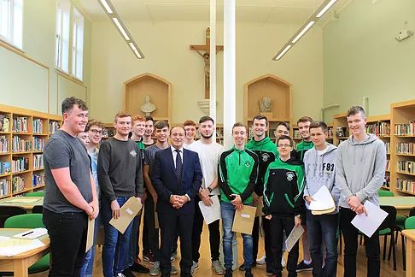
Long Term Vision - Success
At Key Stage 4 our students will embark upon GCSE study.
By starting this process with a well-developed and clear sense of who they are and how they can be successful, enhances their chances of realising their true potential.
The journey to success at GCSE starts now…
Hence, a successful Year 10 can have a direct impact upon the success achieved at GCSE level and beyond.

Slide 16
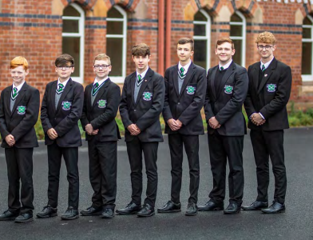
Academic Journey
Key Stage 3 is a vital learning curve and through a process of trial and error, Key Stage 3 students can make mistakes ‘free of charge’.
This allows them to sharpen their academic skills and facilitate progression towards fulfilling their potential.
However, this must all be underpinned with a drive and determination to improve.
These mistakes can only be turned into positives if a student learns from them and takes appropriate action to rectify the issue.

Slide 17
What Makes a Successful Year 10?
At the end of Year 10 we hope to have a cohort of students who feel ready to progress to GCSE study.
To gauge this success, it is important to identify some key objectives.
It is our collective hope that students:
  Chose the best suited combination of subjects that enables GCSE success.
  Progress towards achieving self-identified targets.
  Gain an awareness of what routines and habits facilitate good quality learning.
  Develop effective study techniques and practices.
  Hone additional skills through their participation in extracurricular activities.

Slide 18
Turning Negatives into Positives
In life and in the classroom, there will be brief moments of difficulty. This is where a positive and determined mindset is key.
Roger Federer gestures during Dartmouth College’s commencement ceremony in Hanover, New Hampshire on June 9, 2024.
"When you're playing a point, it is the most important thing in the world…..But when it's behind you, it's behind you. This mindset is really crucial, because it frees you to fully commit to the next point and the next one after that with intensity, clarity and focus…
"You want to become a master at overcoming hard moments. That to me is the sign of a champion”
- Roger Federer

Slide 19
Preparation and Assessments
  Students need to be well prepared for Year 10 assessments throughout the academic year.
  The 2025 Christmas Examination results will be a key benchmark in relation to your son’s GCSE subject choices in Jan/Feb 2026
  We will use the results from this examination series to guide students in the subject choice process.
  These exams will be the most important examinations these students will have taken to date.
  In lessons there will be an emphasis placed upon the importance of these exams, as there also should be at home.

Slide 20

How Can We Make Year 10 Successful?
Staff
Provide high quality teaching and learning
Demand high standards
Model expected behaviour
Give advice and guidance
Communicate effectively with parents/carers
Parents
Make regular check-ups with your son on his progress in school
Develop a routine/timetable for homework and study with him
Monitor his homework and study
Check his work regularly and discuss it with him
Ensure mobile phones, games consoles etc. are used in appropriate amounts
Together
By working together and supporting each other in our roles, we ensure that we maximise our ability to successfully guide each of our students towards realising their potential

Slide 21
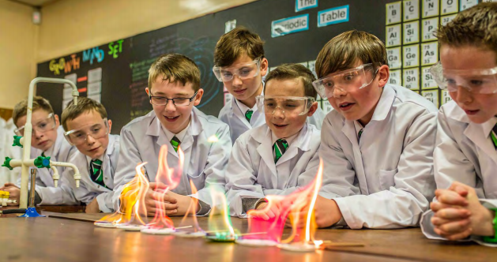
Discussion – A Starting Point
Which successes they would like to repeat?
What mistakes they have made which they wish to avoid in future?
The subjects in which they must work harder to be successful?
The key skills they possess?
Which subjects they are most successful in?
Which revision techniques work best for them?
Which subjects they are passionate about?
What routines help them be prepared for learning well?
Self-Reflection

Slide 22
Promoting Positive Behaviour
We aim to encourage excellent behaviour -
We also understand that there are occasions when students may make mistakes.
Therefore, we will work to support students, celebrate achievement and mentor them when mistakes happen.
Demerits will be communicated to parents via Parent App.
Continued accumulation of demerits will require application of the our ‘Stepped Consequences’.
Tutors and Head of Year will make contact where demerits are being accumulated at defined totals.
For example:
    5 demerits will lead to a Tutor Detention being issued
    10 demerits will lead to a Head of Year Detention
    Beyond this, students will be referred to the Head of School (Mr Heaney)
Tutor or Head of Year Report cards may also be issued as a supportive measure, to monitor a student’s behaviour over a two week window. This gives the Tutor/HOY the chance to discuss issues that may arise, or to congratulate them on excellent behaviour

Slide 23
Uniform
Plain black socks
Plain black school shoes (trainer style shoes are not permitted)
Jewellery must not be worn
Hair- no longer than collar length; no shorter than a number 2 cut
Hair longer than collar-length is not acceptable, even if tied back or up in any way
Students with inappropriate haircuts will be referred to the Head of Year who will contact parents, and a Saturday Detention will be issued

Slide 24
Attendance and Punctuality
Students should aim to keep their attendance as close to 100% as possible
If a student is absent from school for any reason a parent/carer should email the reason to the Form Tutor.
Students should be present in registration rooms before the start of school bell. Registration starts at 9:00am. If they are late, they should sign in at the Office.
If students accumulate 5 ‘lates’ they will be issued with a Tutor Detention.
If a student needs to leave school early for any reason a parent/carer should email their Tutor in advance to inform them of the reason and departure time.

Slide 25
Physical Violence
St Malachy’s College has a zero tolerance approach to physical violence and all parties involved in such instances will be issued with a suspension.

Slide 26
Smoking and Vaping
Although we know that most of our boys are complying with the College rules, we would like to draw your attention to our policies regarding smoking including the use of e-cigarettes.
We have clear sanctions for smoking:
The College forbids a pupil from:
Smoking (including chemical/electronic cigarettes) or bringing cigarettes onto site
And
Smoking, including the use of electronic cigarettes is forbidden and will be dealt with through the College Positive Behaviour Policy and Stepped Consequences
Vaping or possession of a vape will incur sanctions. For a first offence, this will be a Saturday Detention and further infringements will lead to more serious sanctions. Please note that if students are with a group of boys who are vaping, then they may be issued with a sanction even if they are not vaping or in possession of a vape at the time.
Electronic cigarette liquid refill bottles are also forbidden.

Slide 27
Drugs Education Policy
The College Drug Education Policy states that:
  Possession of and/or taking controlled or illegal substances will be dealt with through the Suspensions and Expulsions Policy
  Possession of with intent to supply or supply of controlled substances will be dealt with through the Suspensions and Expulsions Policy and will lead to Expulsion

Slide 28
Addressing Bullying Policy
The Addressing Bullying Policy is in each homework diary
Each student should read this carefully and reflect it in your behaviour towards others
Students have a responsibility to respect the rights of every other individual in the College
Students must treat all others with respect and not engage in bullying behaviour
Students MUST NOT use any derogatory language in relation to disability, race, gender or sexual orientation
‘You do not have to be friends with everyone, but you MUST be respectful towards everyone’

Slide 29
Parent App
Parent App will be used to communicate merits and demerits accrued by your son.
The aim of this communication is to provide you with a real time update on the type of merits/demerits being accrued by your son to facilitate discussion.
Please discuss the reason for the demerit with your son.
Tutors and class teachers will not be available to discuss or justify reasons for giving demerits.
Some notes recorded on our SIMS system appear in red, such as visiting Matron, but this does not indicate a demerit has been issued.
This is pre-determined by the system and cannot be overridden.

Slide 30
Well-Being is Important
There is a team of staff available to support student well-being in the College
If students feel overwhelmed, anxious or are struggling with anything then please encourage them to talk
The Form Tutor, Head of Year, and the staff pictured here are available to support our students
Further support is available to our students through access to a counselling service (and other outside agencies) in school. Information on this is available from Mr Douglas.

