Slide 1
KS3 Head of School & Head of Year Presentation
(August 2023)

Slide 2
Key Messages
To reflect on progress made in 2022/23
To briefly consider KS3 Areas of Focus 2023-26 and share next steps

Slide 3
Whole School Areas of Focus
Raising Standards through High Quality Teaching and Learning
Raising Standards through High Quality Pastoral Care
Curriculum and Extra-Curricular Development to include Collaboration and Careers Education
Pupil & Staff Development, Accommodation and Resources

Slide 4
Progress Made 2022-23
(Raising Standards through High Quality Teaching and Learning)
Key Target – By June 2023 in all departments…there will be a continued focus on improving the Quality of Provision…and impact of the 3 areas which promote successful learning.’ (Planning for learning/Teaching/Assessment)
Actions
Rosenshine’s Principles of Instruction continued to be the focus for the work of the Teaching and Learning group and within Departments (CPD)
Members of the T&L Group shared their experiences and some strategies for Strands 1 & 2 during SDD and Departments asked to progress as appropriate
T& L Group moved their focus onto Strands 3 & 4 – SBP in January and August 2023
KS3 Pupils began to experience lessons in the Digital Hub
Teacher Voice & Pupil Voice was used to get feedback on KS3 Provision (April -June 2023)

Slide 5
Progress Made 2022-23
(Raising Standards through High Quality Teaching and Learning)
Teacher Voice & Pupil Voice April – June 2023
Opinions taken across eight areas
Impact of Rosenshine in the classroom
Digital Hub
TS & PC (Awareness of and opportunities to reflect on skills development)
Employability Skills (Communication/Innovation/Creativity/Entrepreneurship/Critical Thinking)
Careers Education
Preventative Curriculum
Extracurricular experiences
Happiness & Knowing who to talk to

Slide 6
Target Areas 2023-26
(Raising Standards through High Quality Teaching and Learning)
TV & PV Feedback very helpful in determining our next steps for the period ahead
Continued focus on Retrieval Practice and Reteaching Material when necessary (Rosenshine)
Continue to develop Digital Learning opportunities within and between departments (Nerve Centre – ‘Sing’ project)
Continue to strengthen pupils employability skills through their subject learning experiences (Communication/Creativity/Innovation/Entrepreneurship)
Refresh our focus on developing pupils TS & PC (Awareness of, and opportunities to reflect on skills development)
KS3 Careers Provision to be reviewed and updated as required
KS3 Preventative Curriculum is currently being reviewed – updated PV Curriculum in place for 2024/25
Renewed focus on ensuring consistency in KS3 Assessment Practice and pupil feedback

Slide 7
KS3 Outcomes (2023-26)
(Raising Standards through High Quality Teaching and Learning)
‘Strengthening our Learning Culture’
All pupils in every classroom are supported and challenged to do their individual best; this includes a rich and engaging Curriculum and high expectations for T & L to prepare pupils for C21st working and living
A continuing focus on reflecting on the key elements which contribute to high-quality learning experiences for pupils and staff
KS3 pupils will have at least maintained their level of attainment and aptitude in relation to their baseline and be equipped for a smooth transition into KS4. (PTM, PTE, PASS, Year 8 Internal Assessment Data, CAT4, SIMS, Attd)

Slide 8
Progress Made 2022-23
(Raising Standards through High Quality Pastoral Care)
Key Target - ‘By June 2023 SIMS Behaviour and Intervention Data will evidence a consistent application of the ‘Stepped Consequences’ demonstrating that Pupils are being positively supported to meet high expectations for behaviour, attitude and attainment, both during and outside of class contact time.’
Actions
User friendly Behaviour Management Data was disseminated and reviewed on a regular basis by KS3 Pastoral Teams to inform timely interventions
Consistent use of sanctions as per ‘Stepped Consequences’
Behaviour and Intervention Data continued to be shared with Parents/Carers via Parent app
Targeted support for identified cohorts of KS3 pupils to support their progress
Rewarding Pupil Achievement/Embedding Implementation of ‘Positive Behaviour Chart’ (HOY Award introduced in 2022/23 and whole Year Group reward trips reintroduced )

Slide 9
Progress Made 2022-23
(Raising Standards through High Quality Pastoral Care)
In the period 2017-18 – 2022-23 = 208% increase in Merits
In the period 2017-18 – 2022-23 = 47% decrease in Demerits
2023/24 - *New Baseline established for Merits and Demerits*

Slide 10
Progress Made 2022-23
(Raising Standards through High Quality Pastoral Care)
Key Target – ‘Attendance figures will be in line with or exceed the NI average for schools of a similar type and are monitored to ensure that issues can be identified and addressed promptly.’
FT/HOY/HOS analysed attendance data to inform interventions
44 HOS Attendance letters with DENI guidance ‘Attendance Matters’ (Rising from 18 letters previously)
Attendance % | Year 8 | Year 9 | Year 10
2021/22 | 94.05% | 92.4% | 92.58%
2022/23 | 95.6% | 93.45% | 92.46% (12/6/23)

Slide 11
KS3 Next Steps 2023-26
(Raising Standards through High Quality Pastoral Care)
Maintain successful implementation of the College’s Positive Behaviour Management Policy through consistent application of ‘Stepped Consequences’
Implement recommendations from Attendance Policy Working Group
HOS/HOY to regularly link with their Prefect counterparts to oversee the development of the Prefect Leadership role and provide support and guidance
Review KS3 Pastoral Programme to ensure relevance, age appropriate and progression
Embed work of the KS3 Student Council Sub-committee
Embed Positive Behaviour Chart

Slide 12
KS3 Outcomes (2023-26)
(Raising Standards through High Quality Pastoral Care)
The Behaviour Management Policy and Stepped Consequences are fully implemented in an appropriate and consistent manner
Implementation of the Positive Behaviour Chart (inc. Rewards) is sustained and further enhanced, as possible (October 2023 Junior Prizegiving)
The Preventative Curriculum is reviewed and updated to ensure relevant and appropriate educative support to pupils for the issues they may be experiencing inside and outside school
The College attendance figures will be in line or exceed the NI average for schools of a similar type
There are increased opportunities for impactful Student Leadership

Slide 13



YEAR 9 PARENTS’ INFORMATION SESSION
St. Malachy's College, Belfast

Slide 14
Overview
01
Year 9 Expectations
02
Pastoral Team
03
Uniform Policy
04
Attendance and Punctuality Policy
05
Stepped Consequences
06
Positive Behaviour Policy
07
Building on Success

Slide 15


YEAR 9
  Expectations of Our Students
Finding Themselves
Establishing Good Routines
Positive Role Models
Year 8 allows our students to settle into life at the College and manage their transition to secondary education.
Year 9 presents a great opportunity for students to mould their identity in the College and capitalise on all that St Malachy's has to offer
Year 9 is an important year for students. It is also a transition period into Year 10 where important decisions need to be made - GCSEs.
This is the time for our students to build on the strong foundations of Year 8 and develop the skills and qualities needed for success in Year 10 and beyond.
Year 9 signals the end of the 'newcomer' identity of Year 8. Our Year 8s have a strong tradition of excellent behaviour and attainment and it is now the turn of the Year 9s to be fantastic role models to our incoming Year 8s and show them how to be true Malachians.

Slide 16
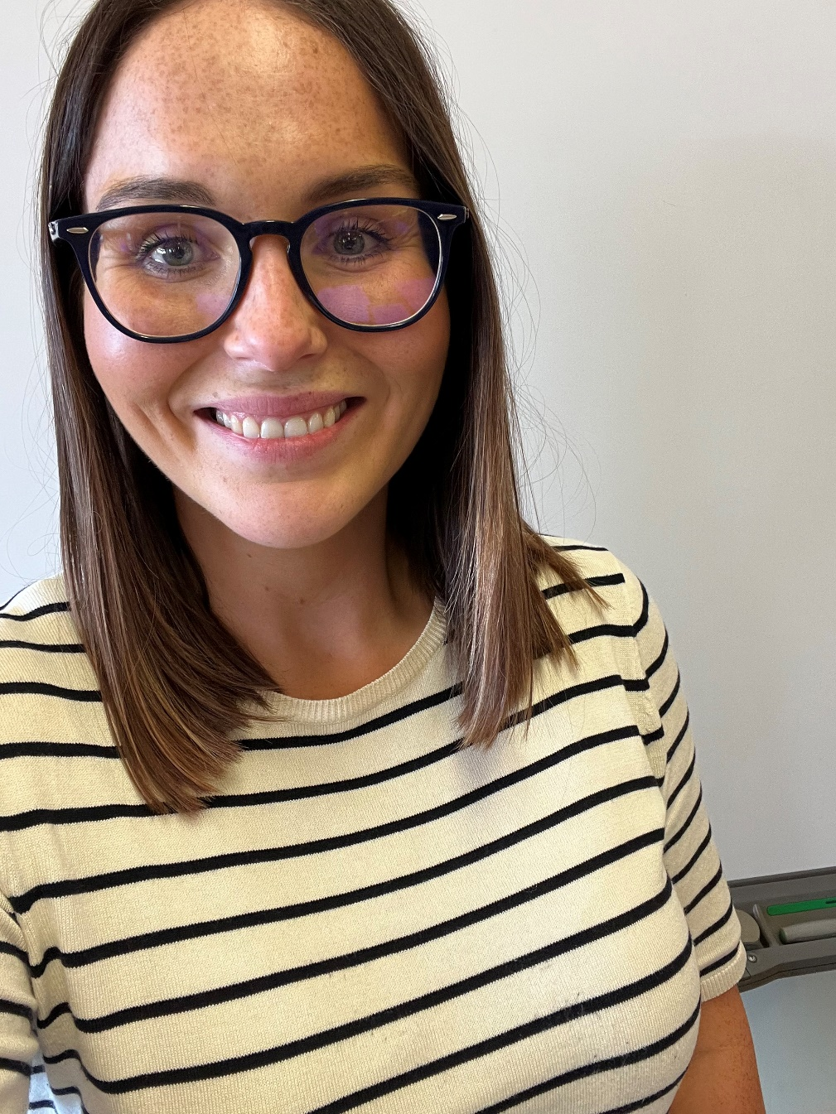
Head of Year 9
Miss T Bell
Email: tbell753@c2ken.net
Religious Studies
Digital Hub
I am delighted to be Head of Year 9 and excited to support the boys this academic year to continue to build on their fantastic success in Year 8.

Slide 17


Year 9 Pastoral Team
Miss O. Montogomery
Mr S. Granville
Mr E. Cooke
Tutor of 9A
Tutor of 9C
Tutor of 9E
Miss T. Bell
Mrs C. Brennan
Mrs N. Jones
Head of Year
Mr R. Crozier
Tutor of 9B
Tutor of 9D
Tutor of 9F

Slide 18
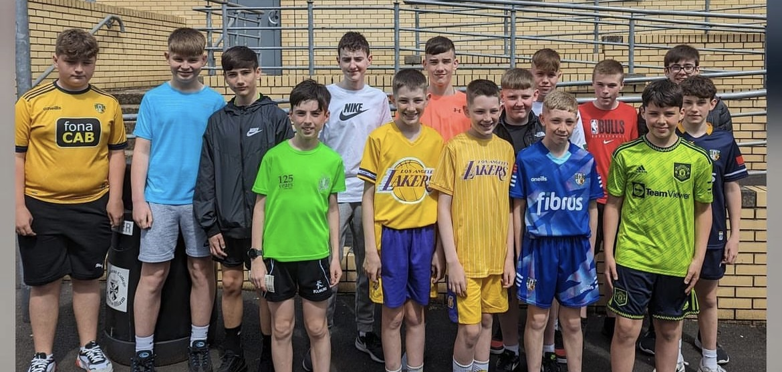
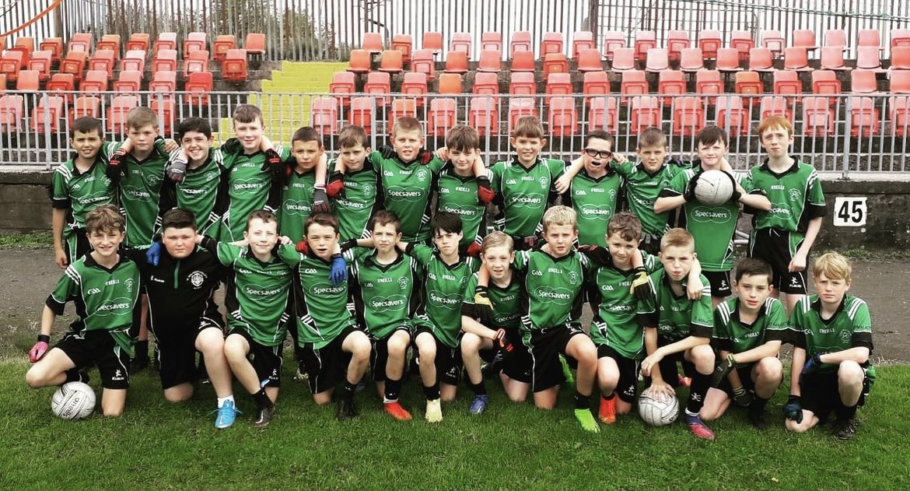
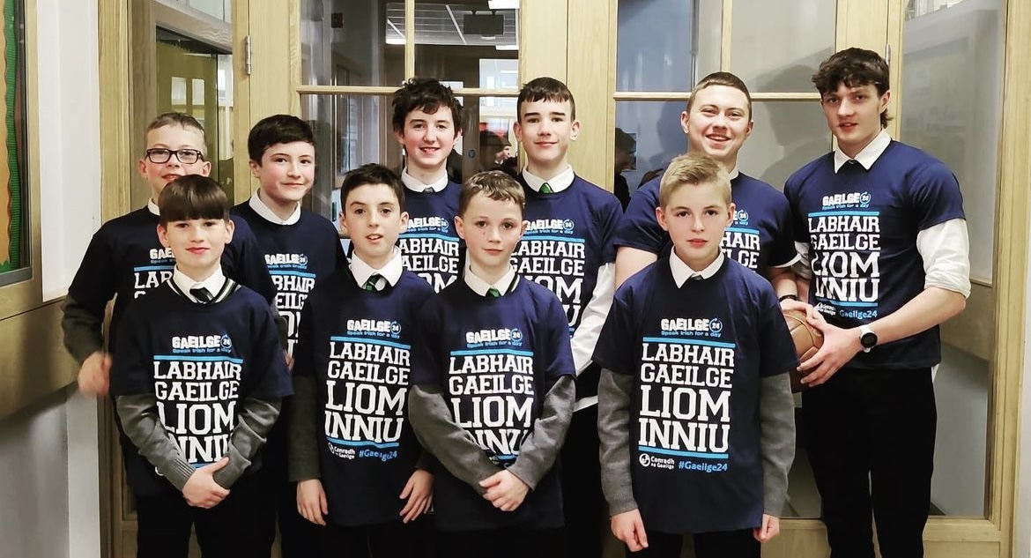
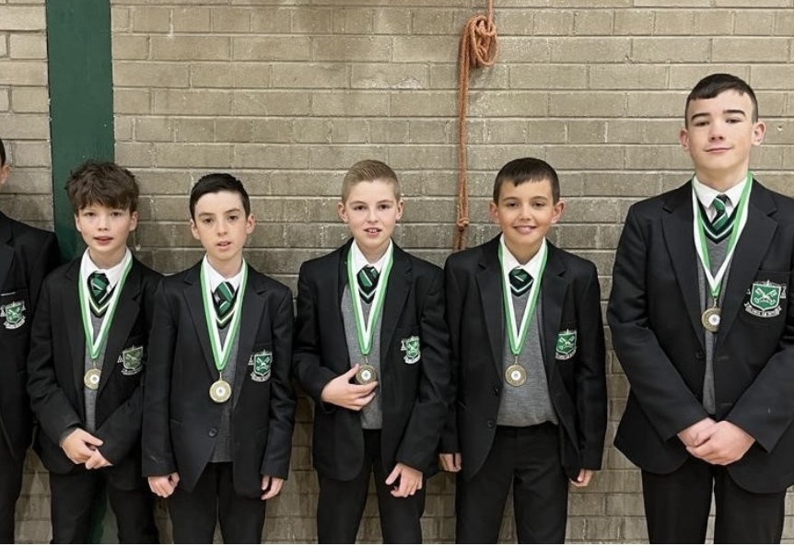
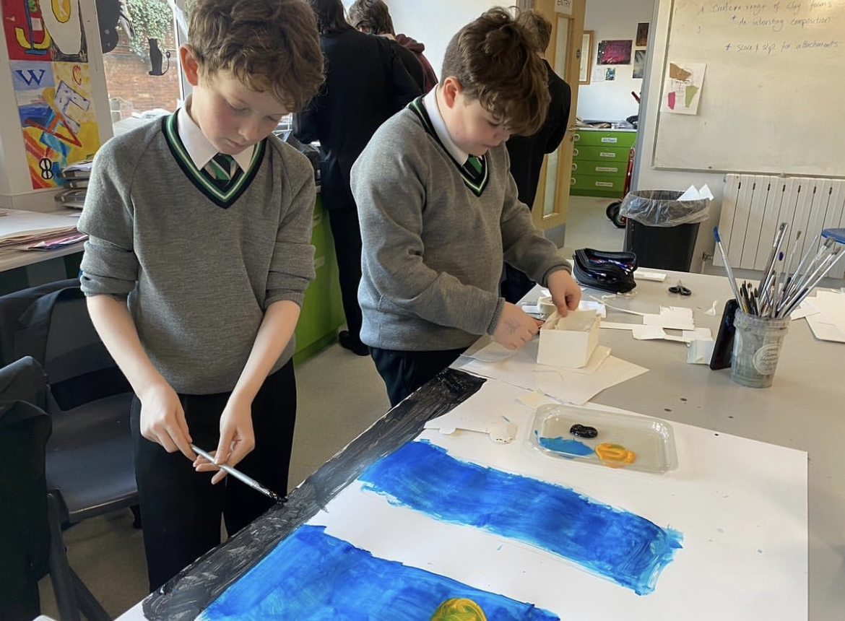
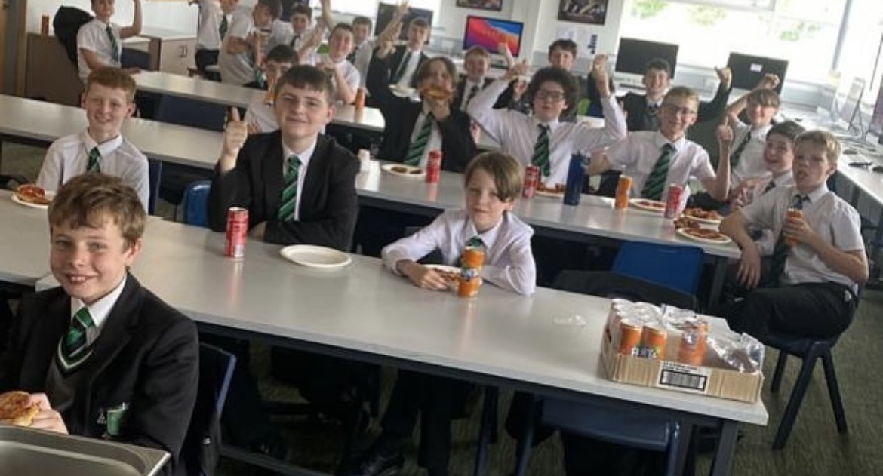

Slide 19

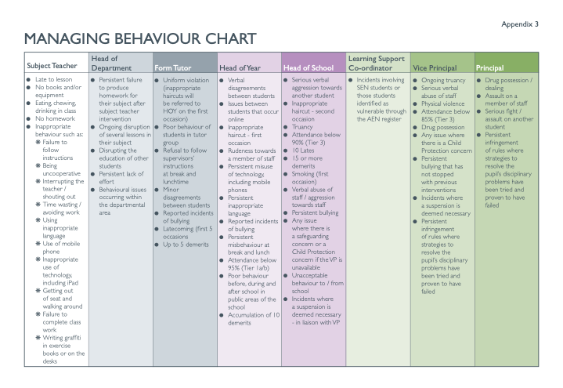
Behaviour Chart
As the previous slide illustrates, the boys’ enjoyed great success last year and this is something we are keen for the boys to continue to build upon.
Success is built on strong foundations and the next few slides are going to recap on the key components the boys need to ensure continue their success.
An accumulation of 5 de-merits will result in a Tutor Detention and a Report Card will be issued for any further de merits as a supportive measure
10 de-merits will be referred to the Head of Year and a Head of Year Detention will be issued and Head of year Report Cards may be issued as a supportive measure.

Slide 20
BEHAVIOUR POLICY
Role Models
Anti – Bully Policy and Physical Violence
Last year, the students not only met but exceeded the high standards we set in St. Malachy’s and we are blessed to have these young Malachians in the College. We have every faith that this year will be no different, the boys have shown they not only know our expectations but can meet them and they will be fantastic role models, not only for our new Year 8s, but the wider College community.
The College believes all forms of bullying is unacceptable and we have a detailed Anti Bullying Policy which can be found in the Homework Diary and on the College Website.
The College has a Zero Tolerance Policy for Physical violence.
Whilst examples of this are rare in the College, serious sanctions will be incurred by all parties involved.

Slide 21
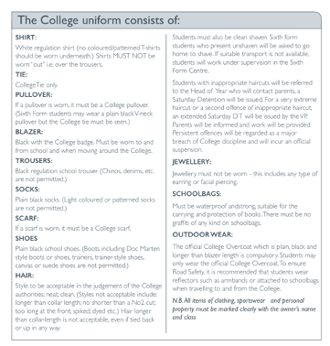
Uniform Regulations
The Head of Year will issue Saturday morning detentions for hair cut breaches on the first occasion.
Students and their parents/carers must ensure that their hair styles are compliant with school regulations by Monday 4th September.
School shoes must be plain black shoes. Examples of shoes that are not acceptable are highlighted in this slide. Sanctions will be issued on the first occasion for inappropriate footwear.

Slide 22
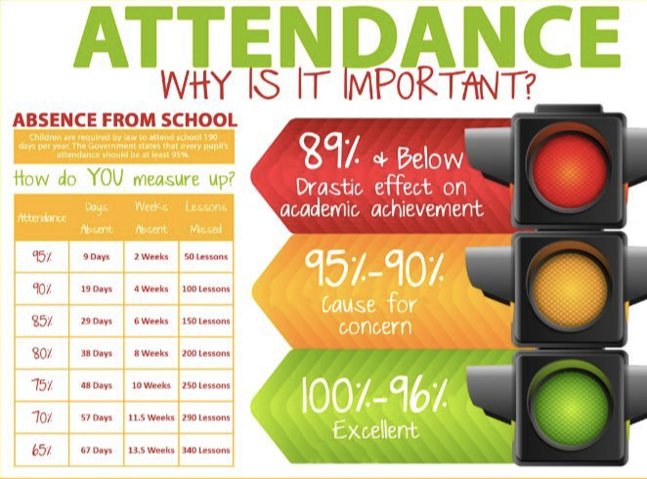
Attendance and Punctuality Policy
The form tutors will monitor students' attendance regularly and issue a Tutor Detention for 5 lates. If there are any SEN/Pastoral concerns the sanction will be discussed with the Head of Year.
The Head of Year will issue a Head of Year Detention for 10 lates unless there are valid SEN/pastoral reasons.
Students are expected to sign the late book in Student reception if they are late to school before heading to class/am reg.
For pre-planned absences, parents/carers are asked to email/send a note to the class tutor with the reason and date.
Students should return to school after a period of absence with a note explaining the reason or alternatively, you can email the class tutor.

Slide 23
ATTENDANCE AND PUNCTUALITY POLICY
Role of Parent/Carer
Leaving School during the day
Family holidays during term time
It is the parent/carer responsibility to inform the College of the reason for a student's absence on the first day of absence.
This should be confirmed with a written note/email to tutor when the student returns to school.
If a student feels unwell during the school day, he must seek permission from a teacher to go to the College Matron. She will contact home as required.
Students must not ring or message home to ask parent/carer to come and collect them.
We have a no phones policy in the College and phones must be switched off for the duration of the school day.
St Malachy's discourages holidays during term time due to the impact they have on students' learning.
Family holidays taken during term time will be categorised as an 'Unauthorised Absence'.

Slide 24

Parent App
The student’s merits and demerits will be communicated to you via ParentAPP
This is an opportunity for you to have a conversation at home that may focus on organisation, behaviour or progress
You will also receive a brief summary of what the merit/demerit was given for.
Please be aware that the form tutors and myself will be monitoring students’ progress and we will contact you if necessary. You do not need to contact the form tutor or class teacher about merits/ demerits.
If you do have any concerns or pastoral issues you would like to discuss, please email me or the form tutor.

Slide 25




Building on Success
Academic Success
Excellent Behaviour
Extra-Curricular Achievement
Academic Success
Excellent Behaviour
Extra Curricular Involvement and Achievement
Last year, the students lead by example and they were rewarded with the end of year Cinema trip. We hope this year our young Malachians continue to demonstrate the high standards and excellent behaviour they have shown us throughout Year 8.
This group of young men have enjoyed success outside the classroom at various levels, in sporting, music, drama achievements and we hope this year is no different. We hope as many students as possible get involved in the extra curricular life of the College.
As Year 9 begins, we hope the students will continue to build upon their excellent academic outcomes. Key to this success will be the completion of homework, participation in class and a well structured revision routine.

Slide 26
KEY INFORMATION
School Resumes on Monday 4th September and is a full day.
Please ensure all students are prepared for school:
Their bag should be packed according to their timetable
Their uniform must comply with College policy including shoes and socks.
Hair should be no shorter than a No. 2 and no longer than collar length. Dyed hair is not acceptable.

